Slide 1
3-5 Discrete Uniform Distribution
Definition

Slide 2
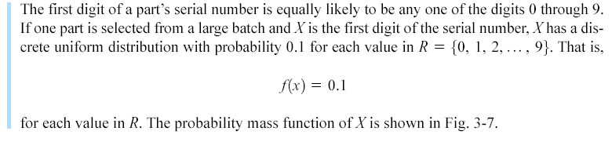
3-5 Discrete Uniform Distribution
Example 3-13

Slide 3
3-5 Discrete Uniform Distribution
Figure 3-7 Probability mass function for a discrete uniform random variable.

Slide 4
3-5 Discrete Uniform Distribution
Mean and Variance

Slide 5
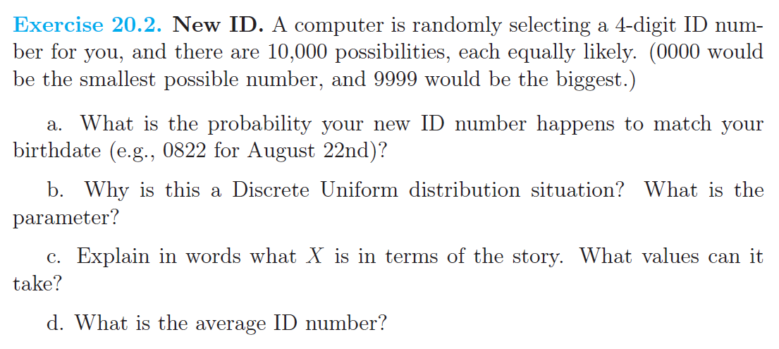
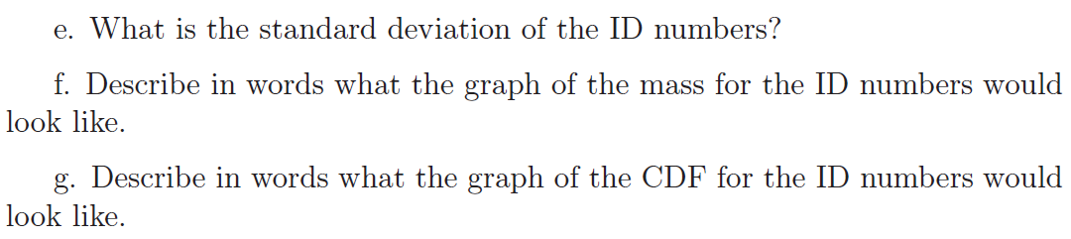

Slide 6
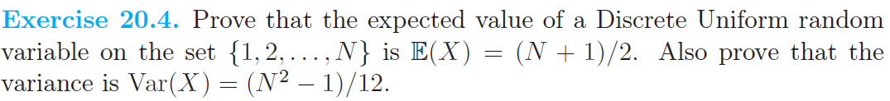

Slide 7
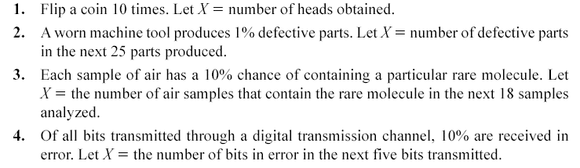
3-6 Binomial Distribution
Random experiments and random variables

Slide 8
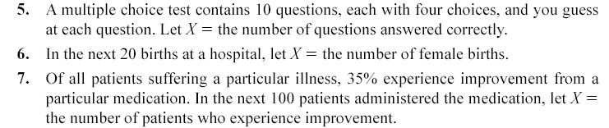
3-6 Binomial Distribution
Random experiments and random variables

Slide 9
3-6 Binomial Distribution
Definition

Slide 10
3-6 Binomial Distribution
Figure 3-8 Binomial distributions for selected values of n and p.

Slide 11
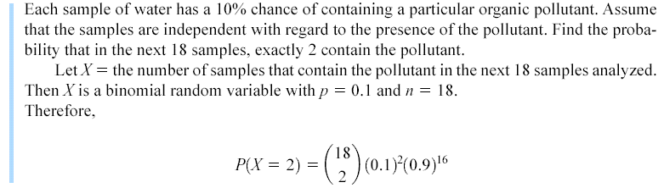
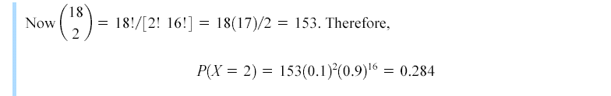
3-6 Binomial Distribution
Example 3-18

Slide 12
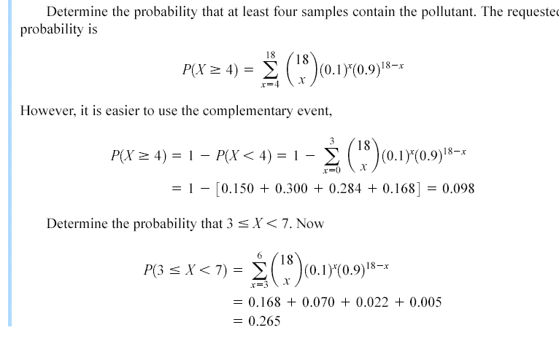
3-6 Binomial Distribution
Example 3-18

Slide 13
3-6 Binomial Distribution
Mean and Variance

Slide 14
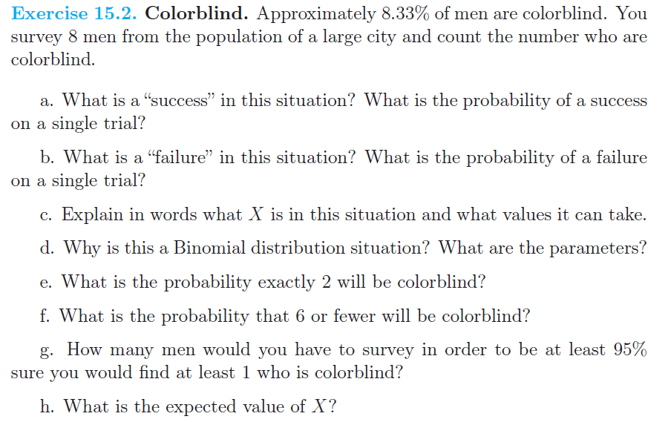
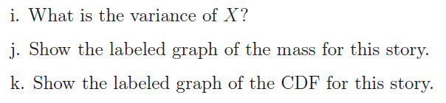

Slide 15
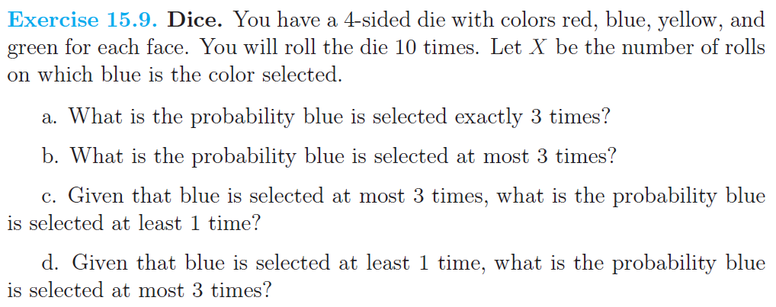

Slide 16
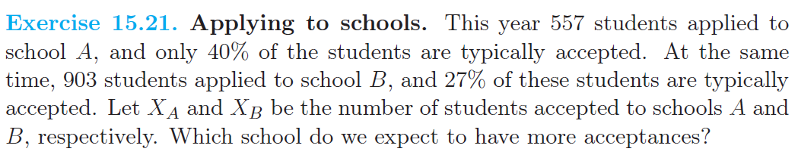

Slide 17
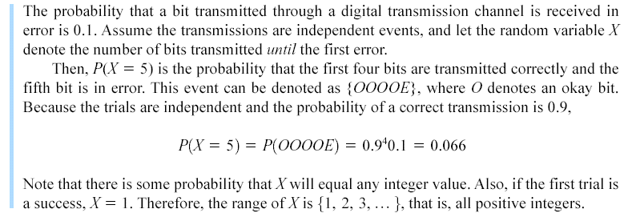
3-7 Geometric and Negative Binomial Distributions
Example 3-20

Slide 18
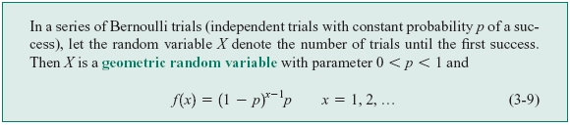
3-7 Geometric and Negative Binomial Distributions
Definition

Slide 19
3-7 Geometric and Negative Binomial Distributions
Figure 3-9. Geometric distributions for selected values of the parameter p.

Slide 20
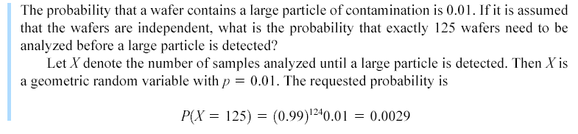
3-7 Geometric and Negative Binomial Distributions
3-7.1 Geometric Distribution
Example 3-21

Slide 21
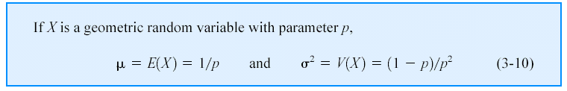
3-7 Geometric and Negative Binomial Distributions
Definition

Slide 22
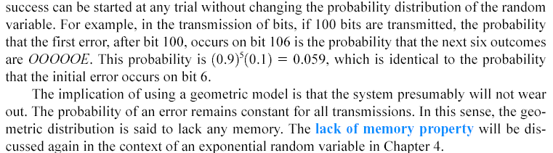
3-7 Geometric and Negative Binomial Distributions
Lack of Memory Property

Slide 23
3-7 Geometric and Negative Binomial Distributions
3-7.2 Negative Binomial Distribution

Slide 24
3-7 Geometric and Negative Binomial Distributions
Figure 3-10. Negative binomial distributions for selected values of the parameters r and p.

Slide 25
3-7 Geometric and Negative Binomial Distributions
Figure 3-11. Negative binomial random variable represented as a sum of geometric random variables.

Slide 26
3-7 Geometric and Negative Binomial Distributions
3-7.2 Negative Binomial Distribution

Slide 27
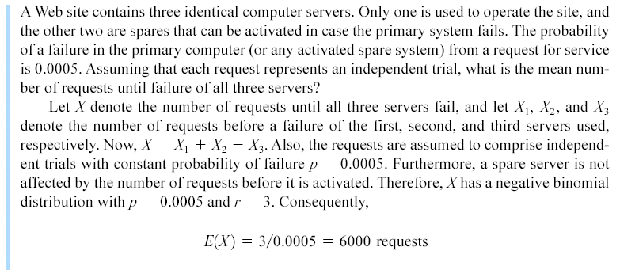
3-7 Geometric and Negative Binomial Distributions
Example 3-25

Slide 28
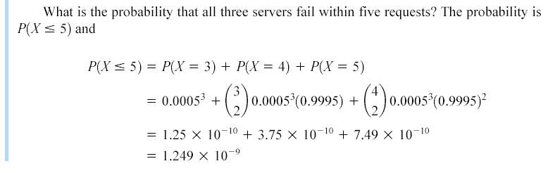
3-7 Geometric and Negative Binomial Distributions
Example 3-25

Slide 29
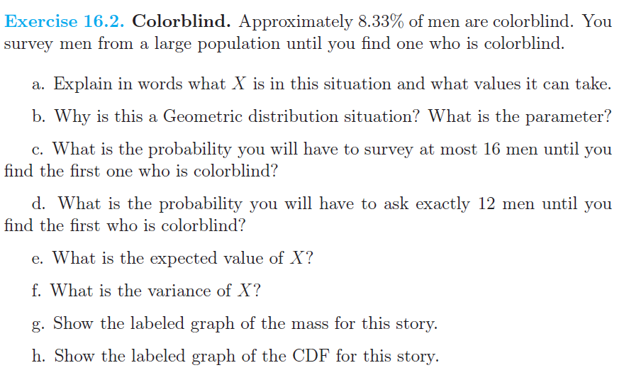

Slide 30
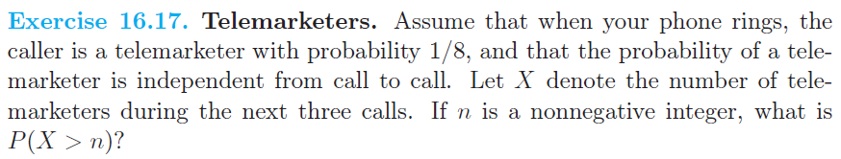

Slide 31
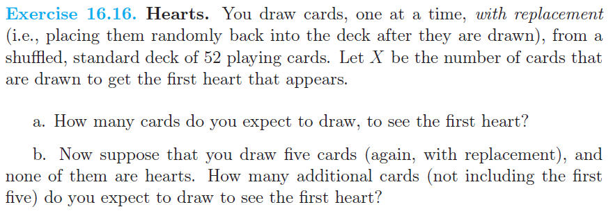

Slide 32
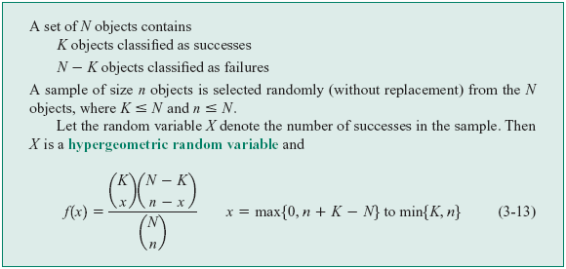
3-8 Hypergeometric Distribution
Definition

Slide 33
3-8 Hypergeometric Distribution
Figure 3-12. Hypergeometric distributions for selected values of parameters N, K, and n.

Slide 34
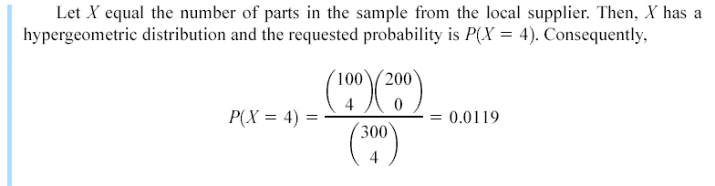
3-8 Hypergeometric Distribution
Example 3-27

Slide 35
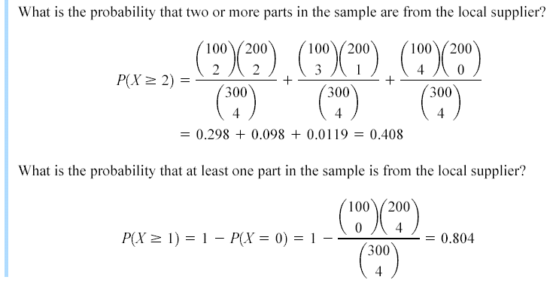
3-8 Hypergeometric Distribution
Example 3-27

Slide 36
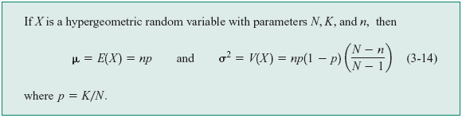
3-8 Hypergeometric Distribution
Mean and Variance

Slide 37
3-8 Hypergeometric Distribution
Finite Population Correction Factor

Slide 38
3-8 Hypergeometric Distribution
Figure 3-13. Comparison of hypergeometric and binomial distributions.

Slide 39
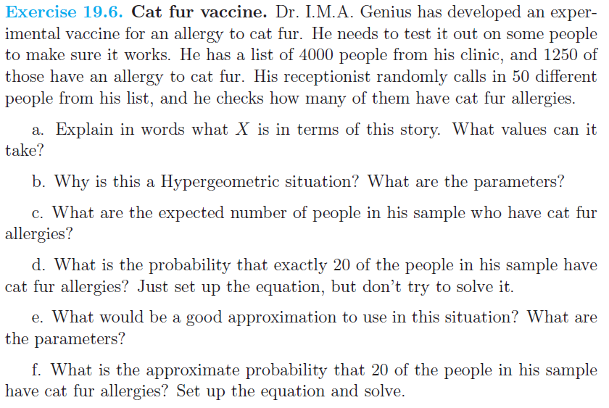

Slide 40
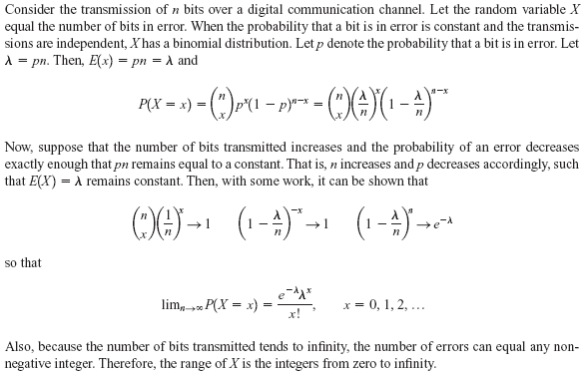
3-9 Poisson Distribution
Example 3-30

Slide 41
3-9 Poisson Distribution
Definition

Slide 42
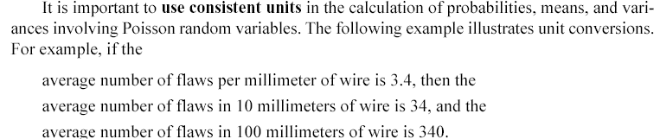
3-9 Poisson Distribution
Consistent Units

Slide 43
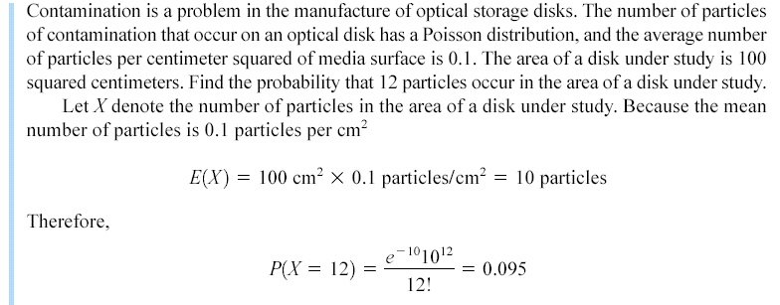
3-9 Poisson Distribution
Example 3-33

Slide 44
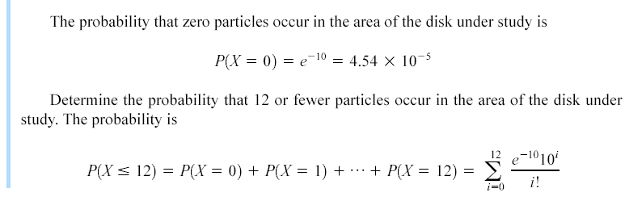
3-9 Poisson Distribution
Example 3-33

Slide 45

3-9 Poisson Distribution
Mean and Variance

Slide 46
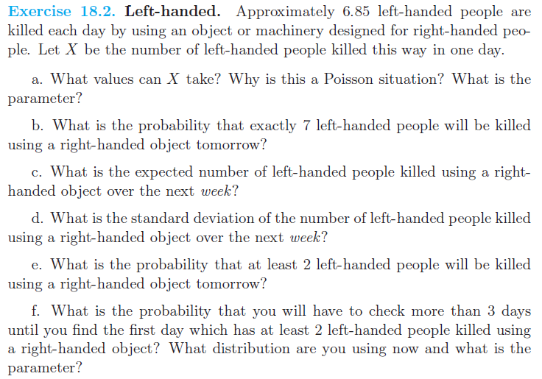

Slide 47
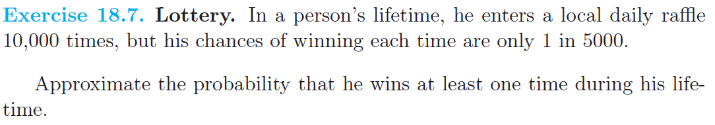

Slide 48
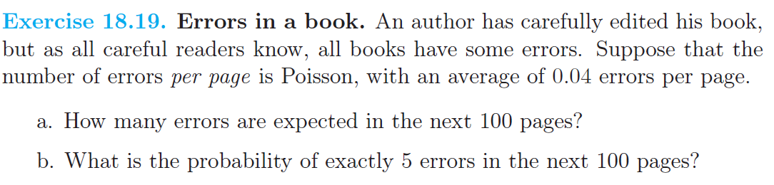

Slide 49
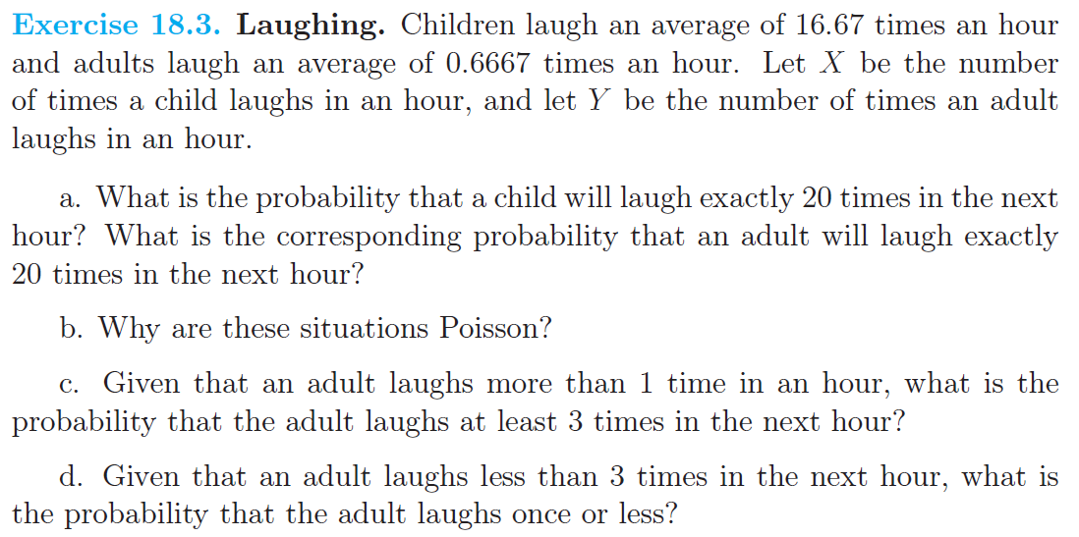

Slide 50
